Slide 1


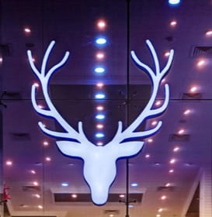

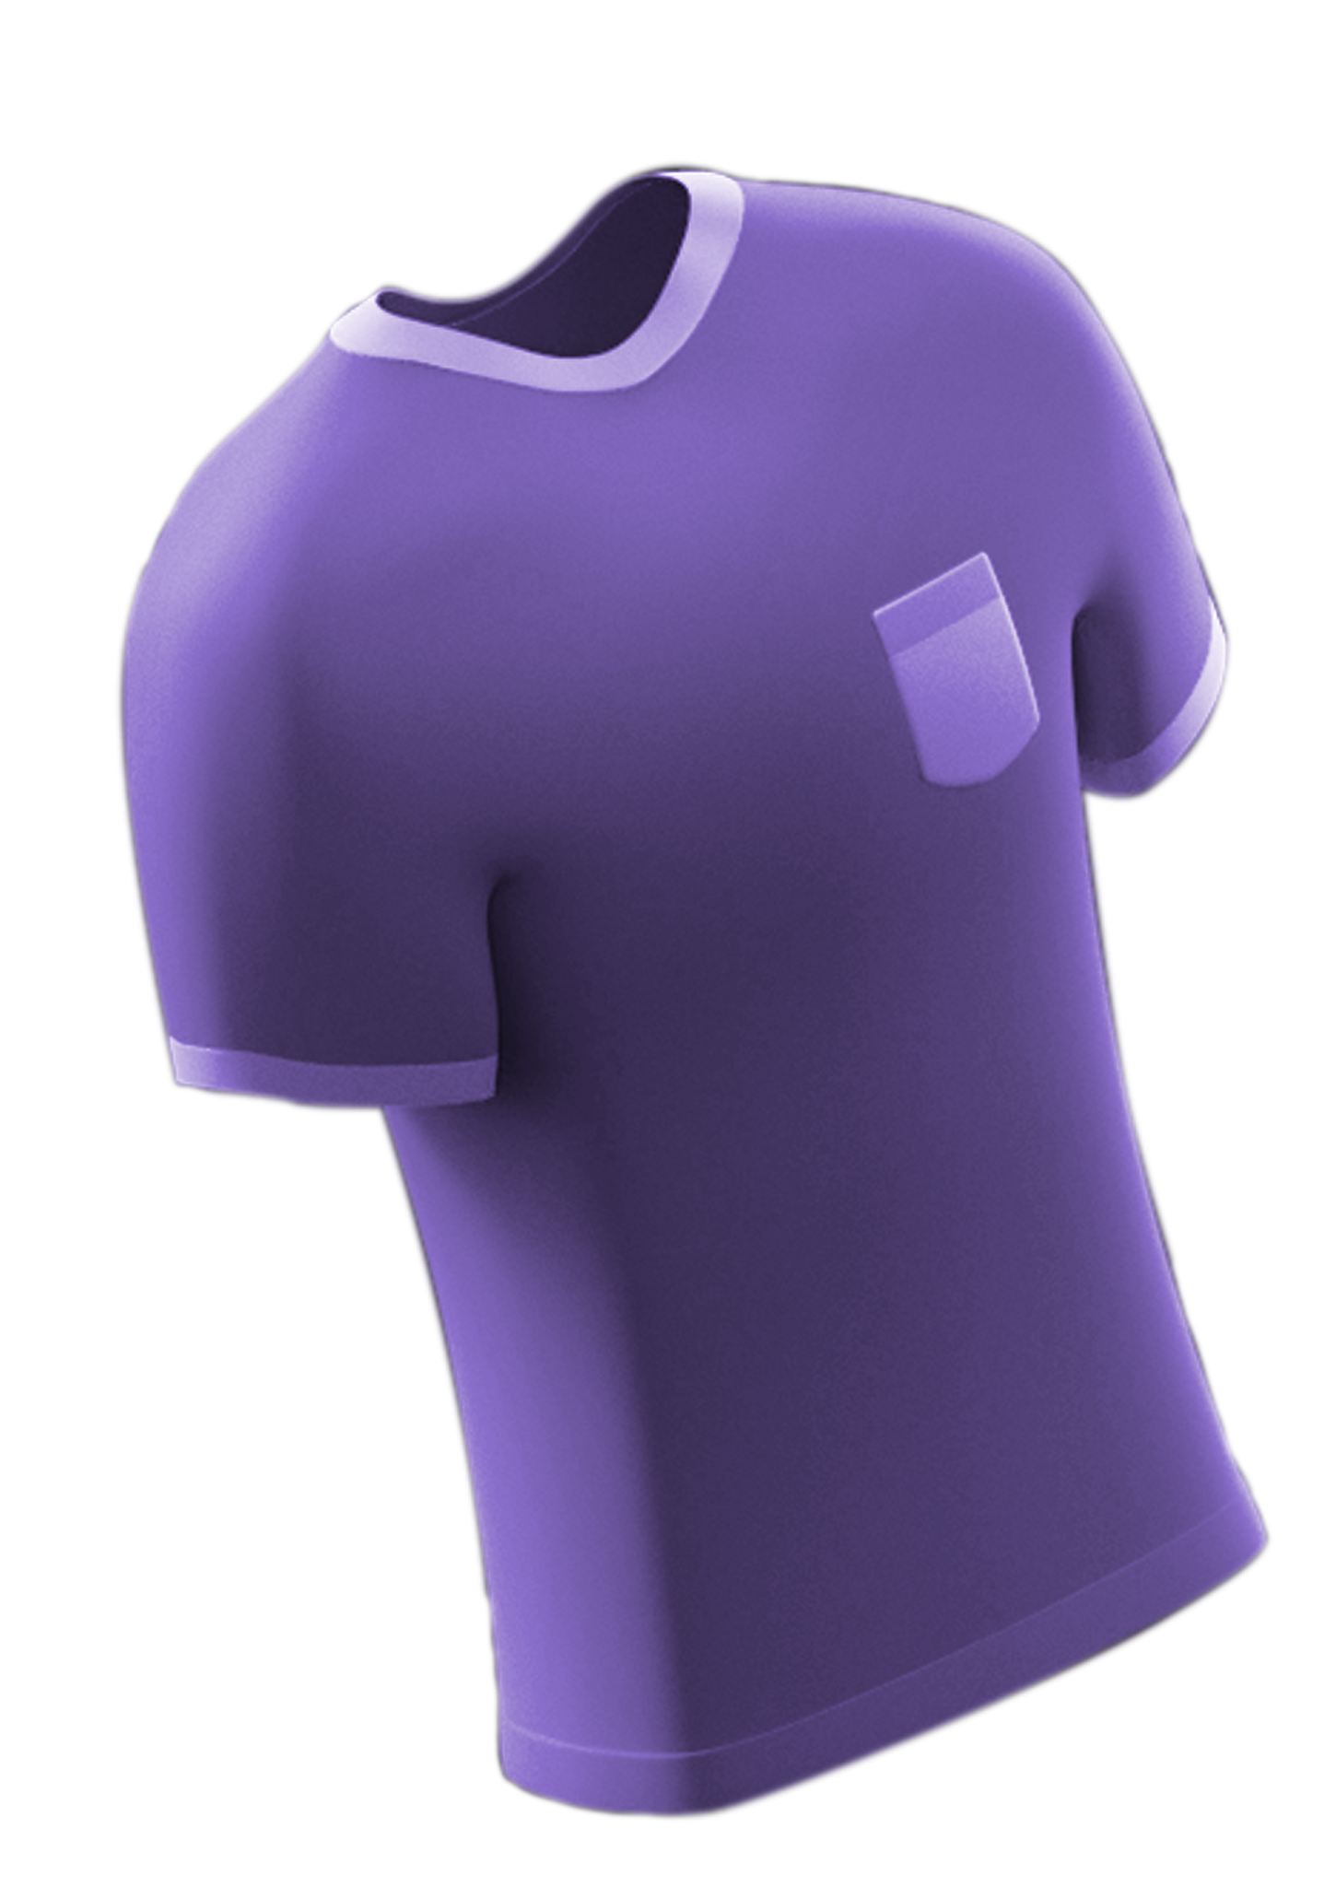
ALLEN SOLLY
Presented by:-
Kolli. Sonia
Kuppili. Pooja
Pagoti. Hemalatha
Dilleswara Goudo

Slide 2
Brand study
BRAND:- Allen Solly was the first Indian brand to enter the shirts and jeans market officially. William Hollin founded Allen Solly and Co Ltd started in 1744. A firm called Madura Garments purchased the brand in the 1990s. Madura Garments was a subsidiary of Madura Coats and a major thread manufacturer.
USP (Unique Selling Preposistion) :-
Allen Solly’s Unique selling preposition(USP) lies in its fusion of work wear and casual wear, creating a distinctive style that sets it apart in the fashion industry. The brand's key USP includes:
Work-Leisure Blend
Contemporary Designs
Versatility
Quality and Durability
Individuality

Slide 3
Brand Study
Mission:- To provide stylish, innovative, and high-quality fashion apparel for men and women, offering a blend of work wear and casual wear that reflects contemporary trends.
Values:-
Style and Innovation
Quality
Versatility
Individuality
Confidence
Analyze Brand Tone and Identity:- Allen Solly is a well-known Indian brand that specializes in men's and women's clothing. Its brand tone and identity can be analyzed as follows:
Casual and Relaxed
Contemporary and Trendy
Vibrant and Playful
Quality and Sophistication
Youthful and Energetic
Versatile and Accessible
Innovative and Tech-Savvy
Indian Heritage with a Global Twist
Socially Responsible

Slide 4
Brand Study
SMART Goals:-
Increase Online Sales: Achieve a 20% increase in online sales within the next fiscal year, compared to the previous year.
Expand Retail Presence: Open three new retail stores in prime locations in key cities within the next 12 months.
Enhance Brand Awareness: Increase brand awareness by 15% through targeted digital marketing campaigns in the next two quarters.
Improve Customer Loyalty: Increase the customer retention rate by 10% by the end of the year through loyalty programs and improved customer service.
Sustainability Initiatives: Achieve a 20% reduction in the brand's carbon footprint by implementing sustainable sourcing and production practices within two years.
KPIs
Conversion Rate: Measure the percentage of website visitors who make a purchase, aiming for an increase in conversion rate.
Foot Traffic: Track the number of visitors to retail stores to assess the success of physical locations.
Social Media Engagement: Monitor likes, shares, comments, and followers on social media platforms to gauge brand engagement.
Customer Lifetime Value (CLV): Calculate the average CLV to understand the long-term value of customers and identify opportunities for improvement.
Inventory Turnover: Measure how quickly inventory is sold and replaced, ensuring efficient stock management.
Market Share: Monitor market share within the fashion industry to assess Allen Solly's competitive position.

Slide 5
Buyer’s / Audience’s persona
Allen Solly is a popular clothing brand in India. Their target audience persona typically includes:
1.Demographics:
- Age: Primarily young to middle-aged adults.
- Gender: Both men and women.
- Income: Middle to upper-middle-class individuals.
.2. Lifestyle:
- Fashion-conscious individuals who appreciate modern and trendy clothing.
- Professionals or those who prefer smart-casual or business-casual attire.
3. Psychographics:
- Trendy and fashionable.
- Socially active and outgoing
4. Behavior:
- Frequent shoppers who keep up with the latest fashion trends.
- May have brand loyalty and prefer to shop at branded stores.

Slide 6
Competitor Analysis
The three competitors of Allen Solly are Raymond ltd, Black berry, Myntra…
Competitor 1:- Raymond ltd
USP:- Known for their exquisite ethnic, indo-western formal and casual fashion apparel, Raymond Fashion is the leading designer lifestyle brand that provides premium styling, quality and value to consumers.
SWOT Analysis:-
Strengths | Weakness | Opportunities | Threats
Strong research and development for product and innovations Loyalty of customers and high product quality Owns 550 stores in more 200 cities across India and overseas | Global penetration is limited as compared to a few other international brands Presence of Indian and international brands offers more offering to customers therefore high brand switching | Consistent growth over years Large and growing market Global expansion would give more opportunities for brand to grow | Regional trade alliances Increased social and ecological awareness will put pressure on company to follow international labor laws and environmental laws.

Slide 7
Competitor Analysis
Competitor 2:- blackberry
USP:-. The company released its phones with secure encrypted network that allowed sending emails between phones without possibility of stealing the information.
SWOT Analysis:-
Strengths | Weakness | Opportunities | Threats
Highly secure phones Strong focus on narrow customer segment | Inability to market the brand BlackBerry OS Highly dependent on government and corporate contracts Poor presence in the tablet market | Growth of tablet and smart phone markets Strong growth of mobile advertising market Increasing demand of cloud based services | Rapid technological change Saturated smart phone markets in developed countries Increased competition for government contracts

Slide 8
Competitor Analysis
Competitor 3:- MYNTRA
USP:- Myntra's unique selling proposition is its wide range of fashion and lifestyle products available online, with a focus on trendy and affordable options, along with convenient shopping features and personalized recommendations.
SWOT Analysis:-
Strengths | Weakness | Opportunities | Threats
Merger with flipkart has increased its strength and capacity Retention of its independence even after merger. Offering of more than 1.5 lakhs products with over 1000 brands | Intense competition means limited market share growth | Selling private labels can increase their margin Bridal collection to tap the big wedding market in India Expansion into global markets can boost business | Global competitors like Amazon slowly making its foray Fashion segment is becoming popular leading to increased competition Economic fluctuations and unfavorable govt policies

Slide 9
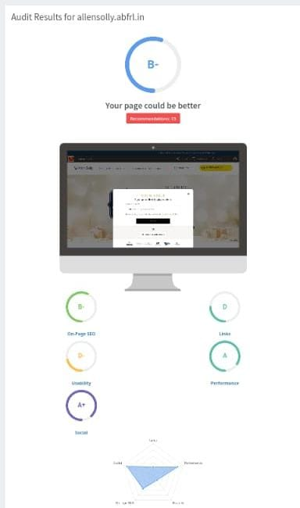
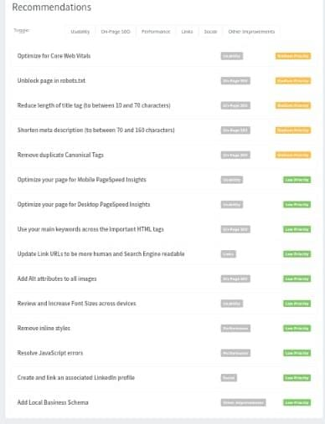
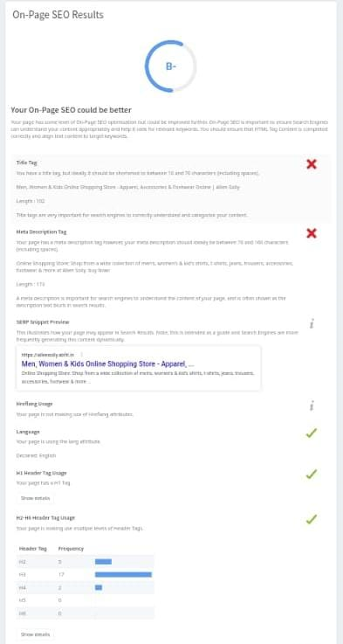
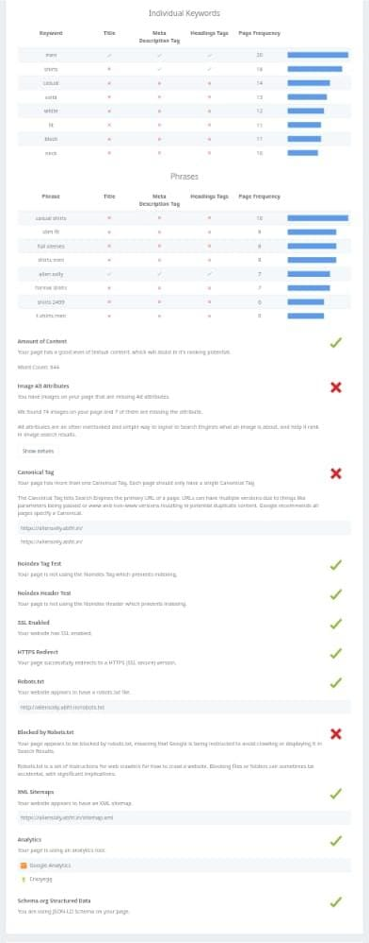
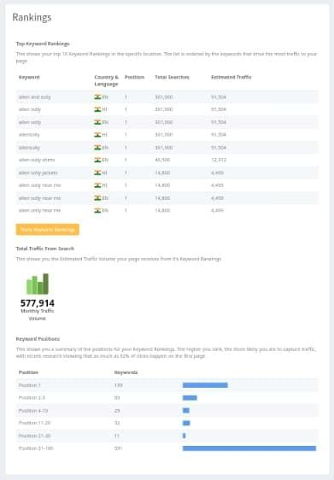
SEO AUDIT OF ALLEN SOLLY

Slide 10
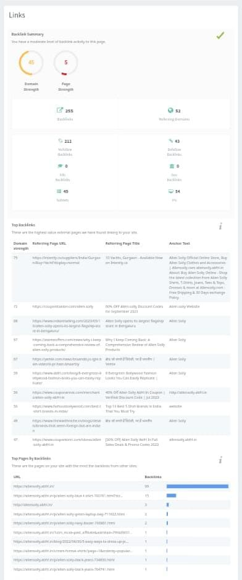
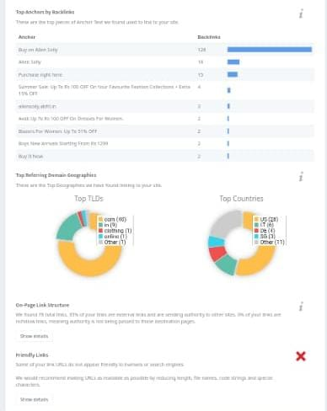
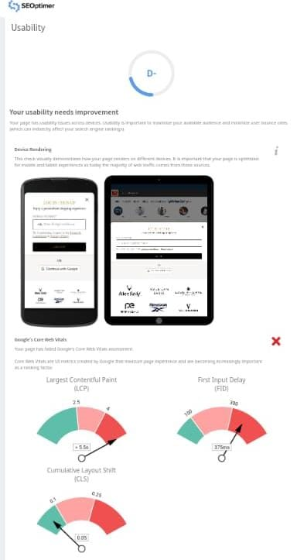
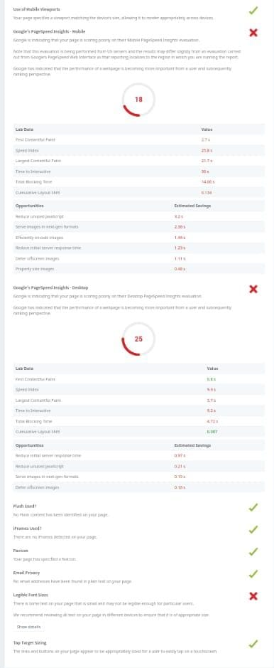
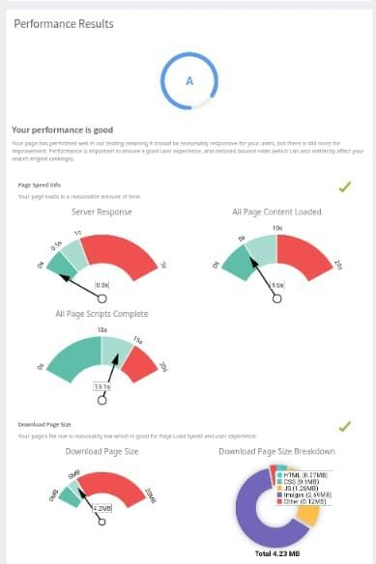
SEO AUDIT OF ALLEN SOLLY

Slide 11
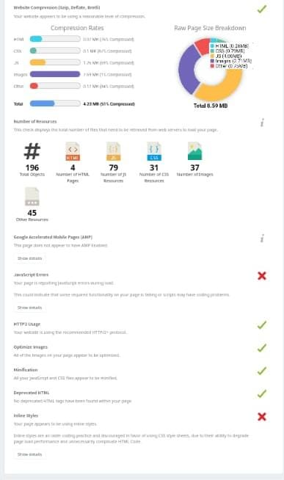
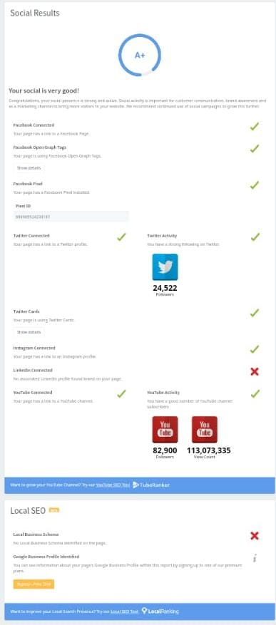
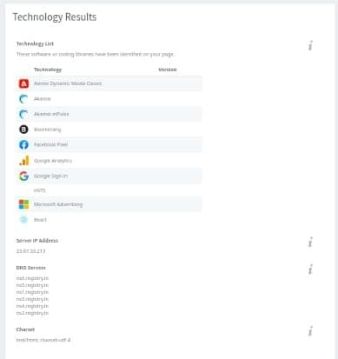
SEO AUDIT OF ALLEN SOLLY

Slide 12
KEYWORD RESEARCH
KEYWORD | VOLUME | COMPETETION | KIP
WOMEN CLOTHS FOR MEN | 950 | 49 | 29
NUDE MEN CLOTHED WOMEN | 320 | 13 | 342
NAKED WOMEN CLOTHED MEN | 320 | --- | -----
MEN WEARING WOMENS CLOTHS | 690 | 30 | 73
MEN IN WOMENS CLOTHS | 780 | 54 | 23
WOMEN IN MENS CLOTHS | 400 | 52 | 22
WOMENS CLOTHS FOR MEN | 340 | 68 | 13
CLOTHED WOMEN NAKED MEN | 300 | ---- | -----

Slide 13
KEYWORD RESEARCH
KEYWORD | VOLUME | COMPETETION | KIP
WOMEN CLOTHS FOR MEN | 960 | 66 | 12
NUDE MEN CLOTHED WOMEN | 600 | 32 | 58
NAKED WOMEN CLOTHED MEN | 621 | 22 | -----
MEN WEARING WOMENS CLOTHS | 699 | 65 | 98
MEN IN WOMENS CLOTHS | 874 | 54 | 32
WOMEN IN MENS CLOTHS | 522 | 63 | 33
WOMENS CLOTHS FOR MEN | 340 | 25 | 96
CLOTHED WOMEN NAKED MEN | 310 | 25 | 36

Slide 14
CONTENT CALENDER
SUNDAY | MONDAY | TUESDAY | WEDNESDAY | THRUSDAY | FRIDAY | SATURDAY
 |  |  |  | 12 | 13 | 14
 |  |  |  | Instagram posts , chats | webinor | Facebook post, reels
15 | 16 | 17 | 18 | 19 | 20 | 21
 | campaign | Group engagement | New blog | Twitter chat | Connecting customers | Product launch
22 | 23 | 24 | 25 | 26 | 27 | 28
 | HOLIDAY | HOLIDAY | HOLIDAY | Update blogs | E-book | Curated content
29 | 30 | 31
 | Employee connection | Customer connection

Slide 15
MARKETING STRATEGIES
Allen Solly is a well-known clothing brand that is part of Aditya Birla Fashion and Retail Limited. Allen Solly has used various marketing strategies to establish its brand presence and connect with its target audience. These strategies may have evolved since then, but here are some common marketing strategies they have employed:
Lifestyle Branding: Allen Solly has positioned itself as a lifestyle brand, emphasizing not just clothing but a way of life. They often showcase their products in lifestyle contexts to create an aspirational image.
Innovative Product Lines: The brand is known for introducing innovative product lines and collections to keep customers engaged and interested in their offerings.
Digital Marketing: Like many fashion brands, Allen Solly utilizes digital marketing channels such as social media, email marketing, and e-commerce platforms to reach a wider audience and engage with customers.
Seasonal Campaigns: They often run seasonal campaigns and promotions to coincide with fashion trends and holidays to boost sales and attract customers.
Customer Engagement: Allen Solly places importance on engaging with customers through events, contests, and interactive campaigns to foster brand loyalty.
Collaborations: The brand has collaborated with other designers and brands to create limited-edition collections, attracting fans of those designers and reaching a broader market.

Slide 16
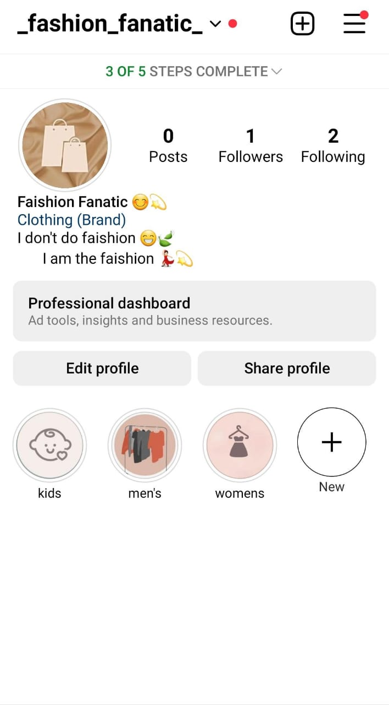
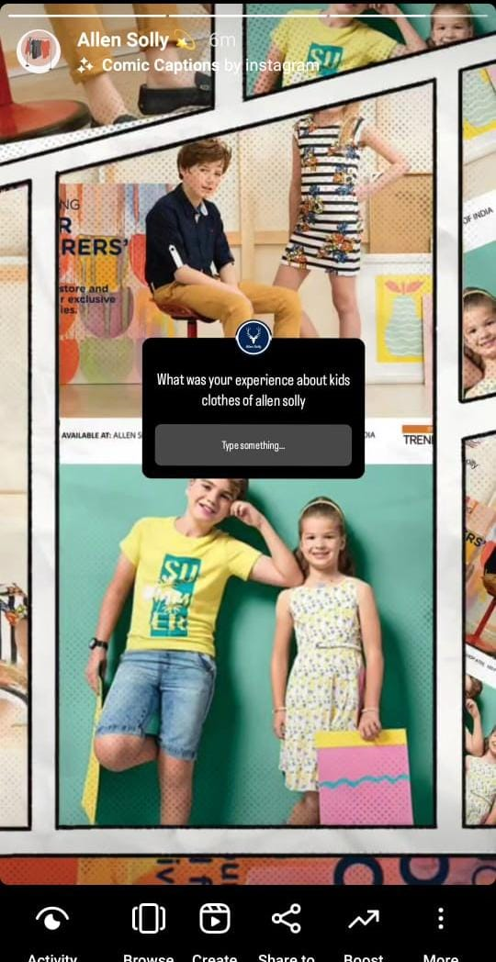
INSTAGRAM STORY

Slide 17
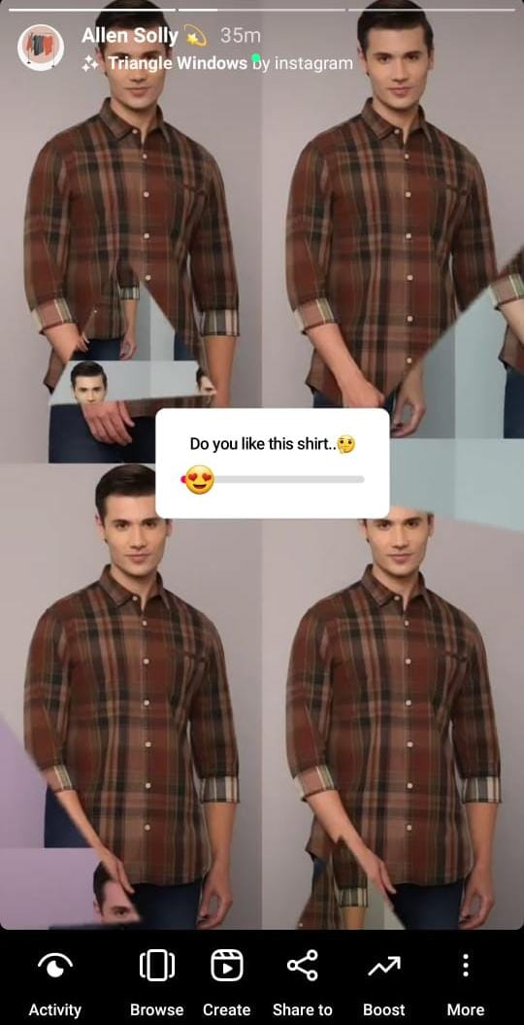
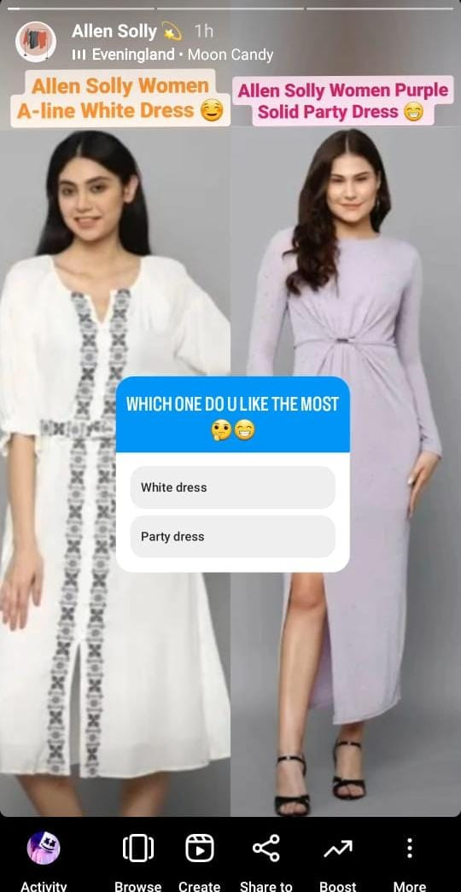
INSTAGRAM STORY

Slide 18
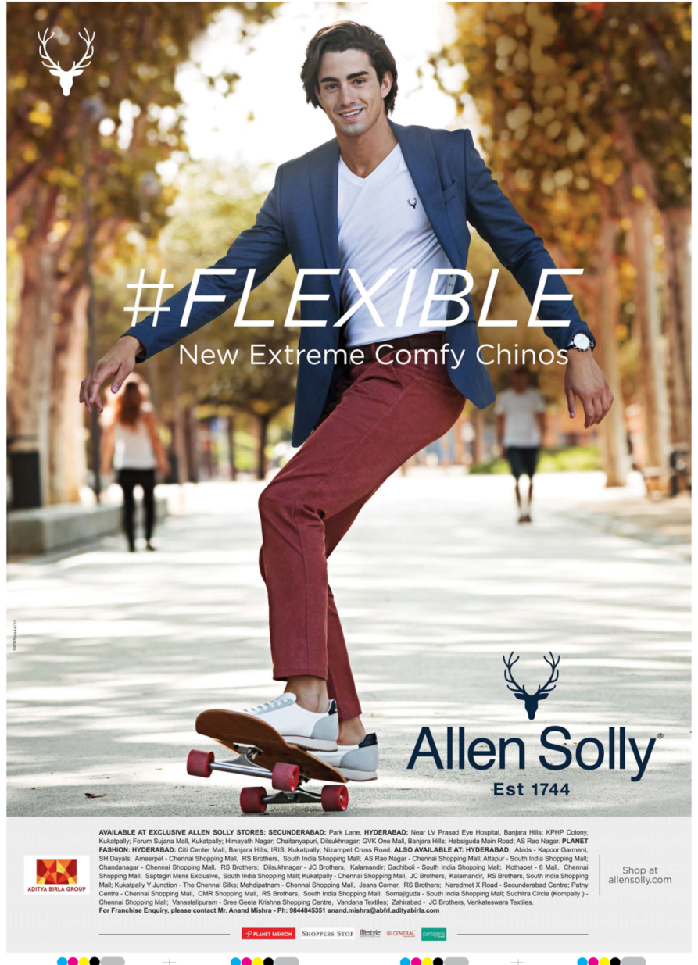
POSTER

Slide 19
ALLEN SOLLY
Instagram url:-
https://instagram.com/_fashion_fanatic_?igshid=OGQ5ZDc2ODk2ZA==

Slide 20
TEAM MEMBERS CONTRIBUTION
1) KOLLI SONIA(TL):- ROLES: Brand study, SEO Audit, Poster creation.
I had done brand study which includes brand research, mission/ values, USP, analyze brand tone, smart goals, KPIs and I had done SEO AUDIT by using Chrome and also I had created poster by using canva.
2) KUPPILI POOJA:- ROLES: Competitor analysis, Keyword research, Instagram story.
I had done competitor analysis, keyword research by using google and also I had created instagram account and I had posted stories in fashion fanatic account.
3) PAGOTI HEMALATHA:- ROLES: Buyers/Audience persona, Instagram story.
I had done buyers/Audience persona with the help of google and also I helped in creation of instagram stories and highlights.
4) DILLESWARA GOUDO:- ROLES: Content calendar, marketing strategies.
I had done content calendar by searching day to day activities of allen solly and also I searched for marketing strategies in google

Slide 21

THANK YOU

